Slide 1
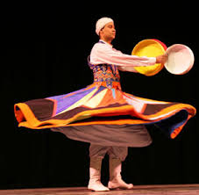
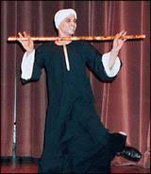
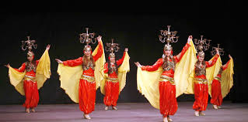
Dances in egypt

Slide 2
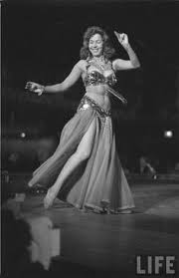
Balady dancing or belly dancing:
Since 20th century, and still very popular now.
Women dance this type of dances in weddings, parties, home and in clubs.
In weddings even women who can’t dance , when they listen to the music they start dancing and have fun.
https://youtu.be/cKEjKJDyK1k

Slide 3
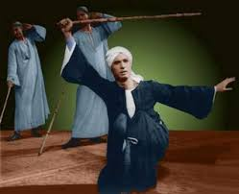
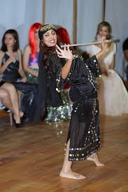
Saidy dancing or cane dance:
Popular in upper Egypt.
Usually men or women dance with a cane in their hands and wearing galabeyahs.
Energetic music is used to help them to dance better.
https://youtu.be/KI-fkEBvpAU

Slide 4
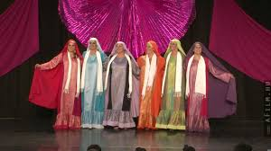
Nubian dance:
There are many types of Nubian dances.
Popular in southern Egypt and sudan.
Types: kensi and fadiki.
https://youtu.be/MJbnN0kJJ-A

Slide 5
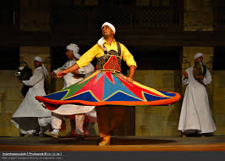
Sufi dance or Tanoura:
An Egyptian folk dance.
It’s performed by sufi men in special parties.
The costume is a weighted skirt to dance with.
Skirt in Arabic is tanoura that’s why it’s called tanoura dance.
https://youtu.be/fZ9TagGEd8o

Slide 6
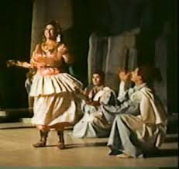
El hagalla dance:
It’s a folk dance.
Popular in western Egypt.
Bedouin dance.
It’s related to kaf (clapping).
It’s performed at weddings and engagements.
https://youtu.be/Q8EvMjM5IKo

Slide 7
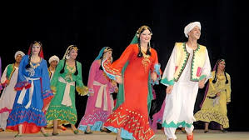
Most popular band for folk dance in Egypt:
Reda band
Halawet shamsena dance (the beauty of our sun)
https://youtu.be/Nv8-5hN3MPY

Slide 8
Thank you Any question?

