Slide 1
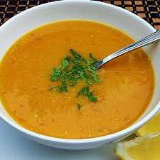
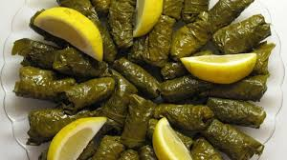
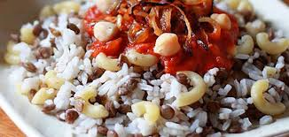
National dishes in Egypt

Slide 2
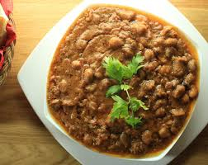
Breakfast:
Fool.
فول.
Ingredients: Beans, chickpeas, tomatoes, onion, wheat, lentils.
https://youtu.be/NdMlY2iv3og

Slide 3
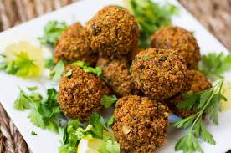
Breakfast:
Taameya.
طعمية
Ingredients: beans, celery, red onions, green onions, garlic, parsley, salt, pepper.
https://youtu.be/q4Jt256DWsA

Slide 4
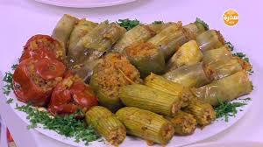
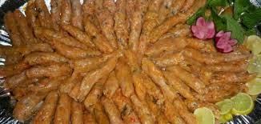
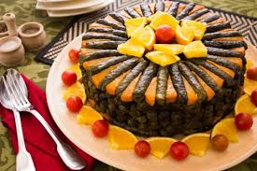
Lunch or dinner:
Mahshy.
محشي.
Ingredients: rice, parsley, celery, onion , garlic, tomato sauce, salt, black pepper, spices of your choice.
You can do mahshy with many vegetables like: grape leaves, cabbage, eggplant, zucchini, tomato , pepper.
https://youtu.be/QCy8Ips_C90

Slide 5
Lunch or dinner:
Koshary.
كشري
Ingredients: rice, macaroni, chickpeas, black lentils, onion, salt, black pepper. Tomato sauce, vinegar.
Most popular for all Egyptians and it's cheap.
https://youtu.be/r6xqu2pIM5I

Slide 6
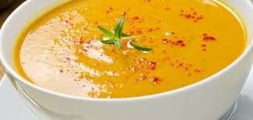
Soup:
Lentils soup.
شوربة العدس
Ingredients: yellow lentils, onion, potato, tomato, garlic, carrot, cumin, salt, black pepper,
Favorite soup for Egyptians in winter.
https://youtu.be/peXVjc3fPDE

Slide 7
Thank you

