Slide 1
Algerian food
What do you like to eat in general?

Slide 2
A video about algerian daily life
https://www.youtube.com/watch?v=UhoAq7wKjTQ
https://www.youtube.com/watch?v=vJs3yprr1P4

Slide 3
History of food in algeria
Algerian cuisine traces its roots to various countries and ancient cultures that once ruled, visited, or traded with the country. Berber tribesmen were one of the country's earliest inhabitants. Their arrival, which may extend as far back as 30,000 B.C., marked the beginning of wheat cultivation, and fruit consumption, such as dates. The introduction of semolina wheat by the Carthaginians (who occupied much of northern Africa)
Berbers are the firsts who create couscous , Algeria's national dish. The Romans, who eventually took over Algeria, also grew various grains. At the beginning of the twenty-first century, Algeria ranked among the top ten importers of grain (such as wheat and barley) in the world,

Slide 4
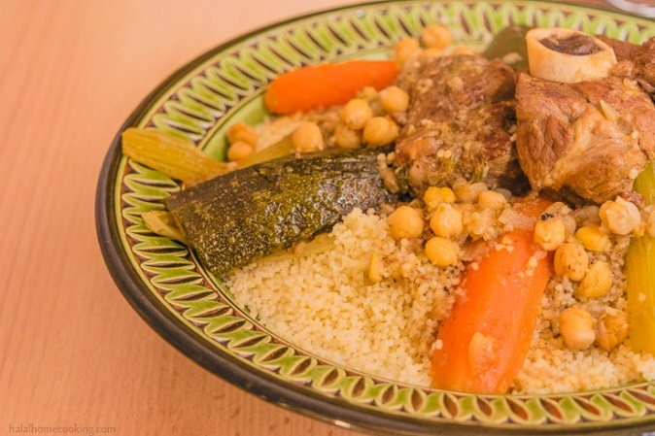
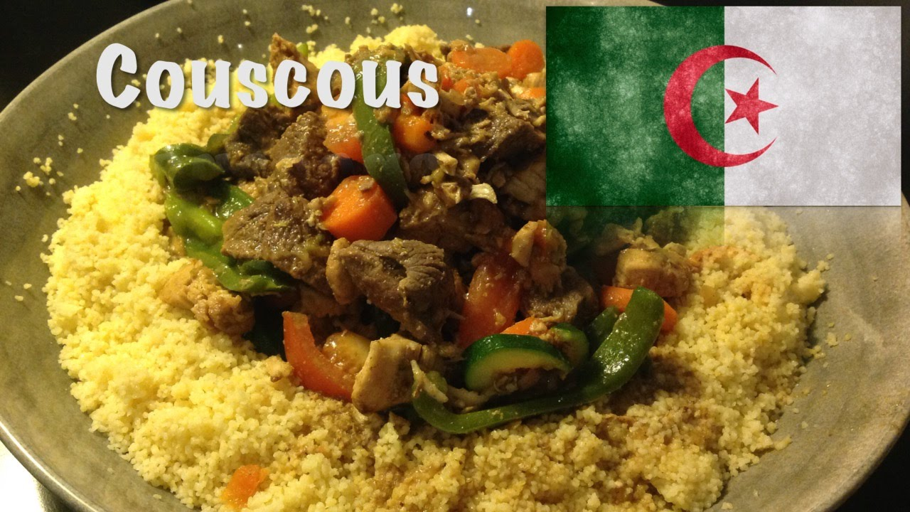
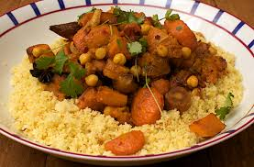
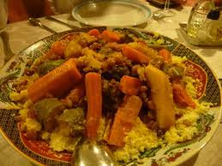
Couscous

Slide 5
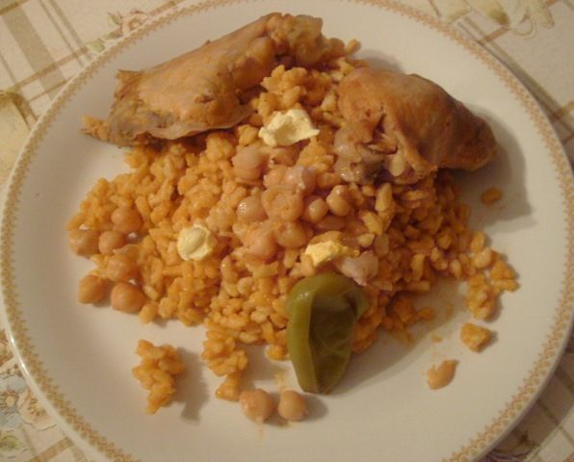
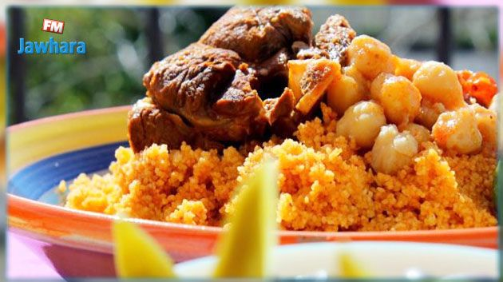
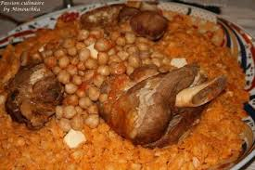
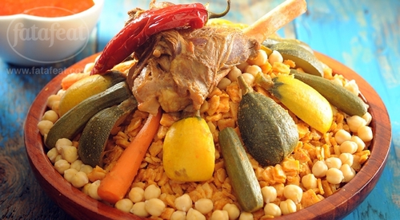
chakhchoukha

Slide 6
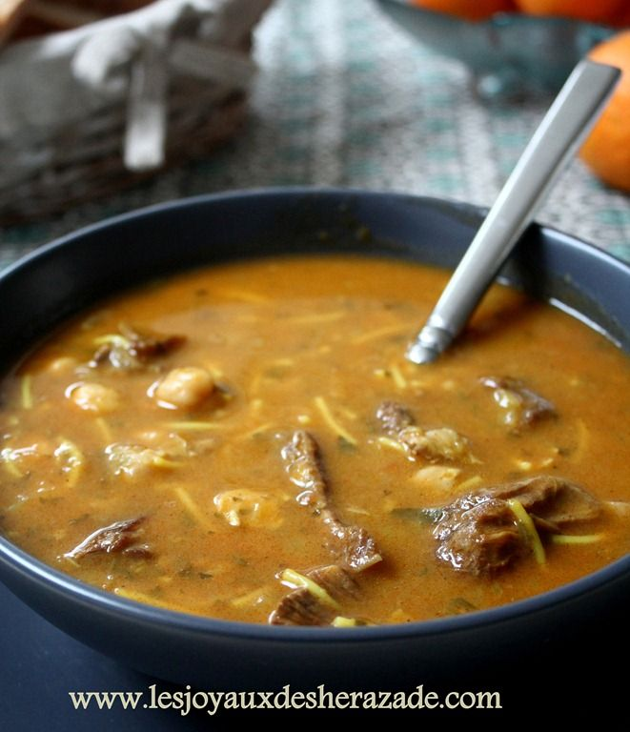
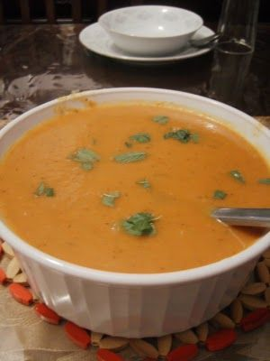
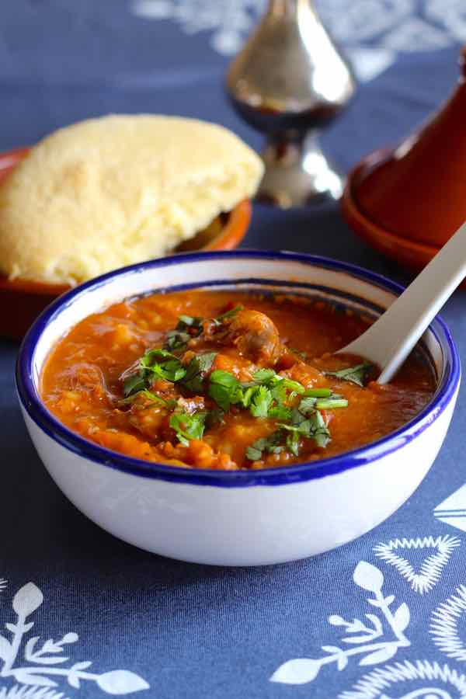
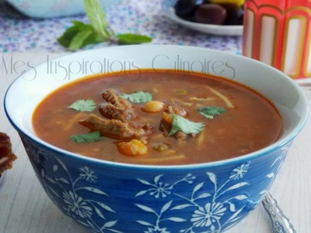
Chorba and hrira
This is a kind of soups, known in algeria especially in ramadane for mouslims

Slide 7
What about spicy food in algeria?
The palette of Algerian ingredients is essentially Mediterranean, including lamb, chicken, tomatoes, olives, peppers, eggplant, lentils, oranges and lemons. Spicy Algerian merguez sausage is famous around the world.
Traditional Algerian cuisine, a colorful combination of Berber, Turkish, French, and Arab tastes, can be either extremely mild or packed with flavorful seasonings. Ginger, saffron, onion, garlic, coriander, cumin, cinnamon, parsley, and mint are essential in any Algerian pantry.
No Algerian meal would be complete without bread, normally a long, French loaf. Similar to Middle Eastern customs, bread is often used to scoop food off of a plate or to soak up a spicy sauce or stew. More traditional Berber families usually eat flat, wheat bread.

Slide 8
Food for religious holidays
The overwhelming majority of Algerians, about 99 percent, follow the beliefs of Islam, the country's official religion (Christians and Jews make up only 1 percent of the population).
The Algerian observance of Ramadan, the ninth month of the Islamic year (most often November or December), is the most celebrated of all holidays. During the monthlong observance, Muslims are required to fast (avoid consuming food and drink) between sunrise and sunset, although young, growing children and pregnant women may be allowed to eat a small amount. At the end of each day during Ramadan, sometimes as late as midnight, families join together for a feast. French loaves or wheat bread and a pot of hot mint tea will likely serve as refreshments.
The meal marking the end of Ramadan, Eid al-Fitr , is the most important feast. It almost always begins with soup or stew. Lamb or beef is most often served as the main dish, although families living close to the Mediterranean in northern Algeria enjoy a variety of seafood. In most Algerian homes, a bowl of fresh fruit is placed on the table at the end of the meal. Traditionally, each person is responsible for peeling and slicing his or her own fruit. However, on special occasions such as Eid al-Fitr , the host will often serve the fruit already peeled, sliced, and flavored (most often with cinnamon and various citrus juices).

