Slide 1
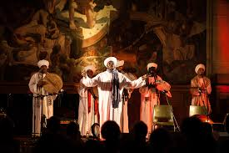
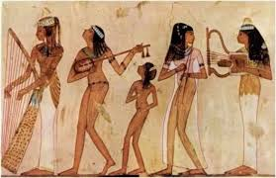
Music in Egypt
By: Maysan Tarek

Slide 2
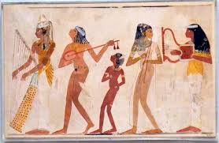
Ancient Egyptians:
Music has been an essential part of Egyptian culture since ancient time.
Ancient Egyptians credited God Thoth with the invention of music.
Music was always played in special occasions and whenever they want to relax.
In religious occasions also music was a big part of it and we new that because it is drawn on the temples’ walls.

Slide 3
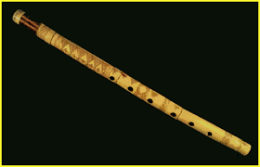
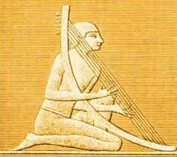
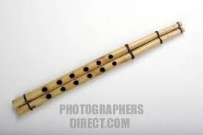
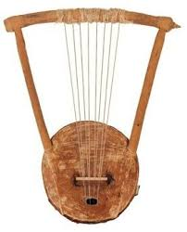
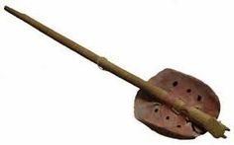
Instruments used:
1
2
Flute.
Harps.
Double clarinets.
Lyres.
Lutes.
3
4
5

Slide 4
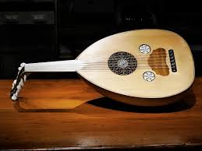
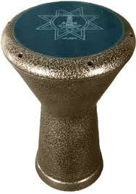
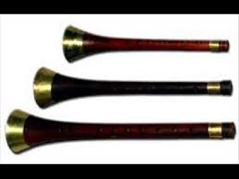
Bedouin Music:
3
This kind of music in fount in the desert of the west and the eastern Sinai area.
Instrument used:
The mizmar, kind of clarinet.
Tabla, kind of drum.
Rababa.
Oud.
4
1
2

Slide 5
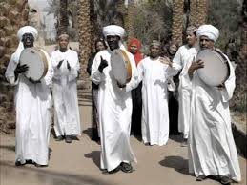
Nubian Music:
Nubians are native in south Egypt and north of sudan.
Nubian is still played until now.
There are many Nubian artists in Egypt like Mohamed Mounir, who sings in Nubian and Egyptian Arabic.
https://youtu.be/YzrieEGWFJM

Slide 7
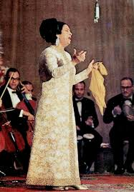
Popular music: (Classical music)
Untill late 1970s there were classical singers like Um Kulthum.
By mid 1990s shaabi music had taken over, especially among younger audience.
Most of them were even love songs or historical songs.

Slide 8
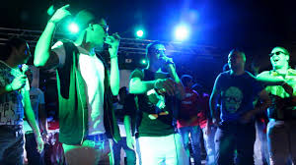
Shaa’bi:
It started being a part of music in the middle of 1990s and many people didn’t like it and said it’s not art.
But since 2000s most of the Egyptians started listening to shaabi songs.
It’s very popular and helps to dance.
https://youtu.be/CqjZPnmcBCA

Slide 9
Most popular Shaabi song in Egypt now: (Mafia)

Slide 10
Evolution of Egyptian Music:
https://youtu.be/cPvyl6MYxlg

Slide 11
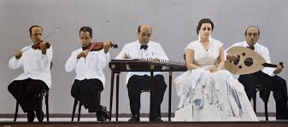
Thank you

