Slide 1
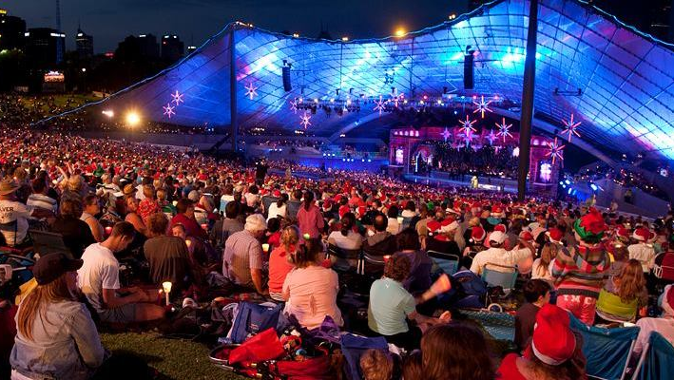
Australian music
Jordon young

Slide 2
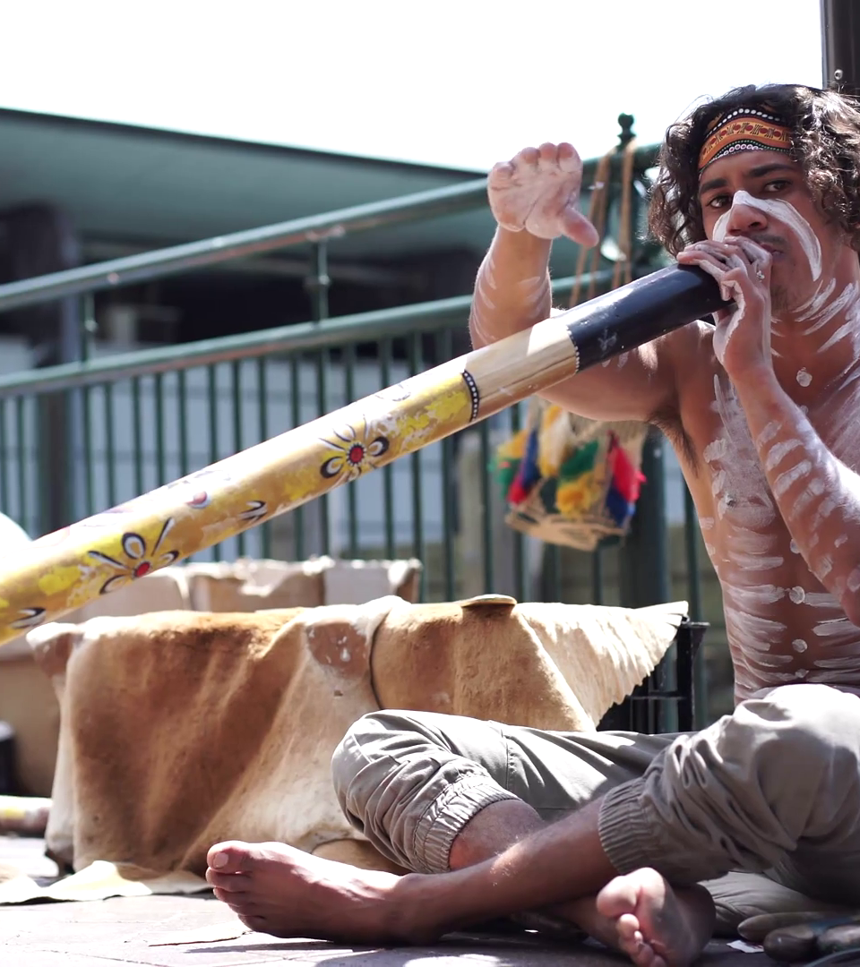
TRADITIONAL ABORIGINAL MUSIC
Played by the aboriginal people during ‘Coming of Age’ ceremonies, where boys become men.
Played with instruments such as the didgeridoo (made from a hollowed-out log) and noise makers.
Includes many players and involves many of the same instruments.
Aboriginal people dance and feast during these ceremonies
Indigenous Australian Playing didgeridoo (click).

Slide 3
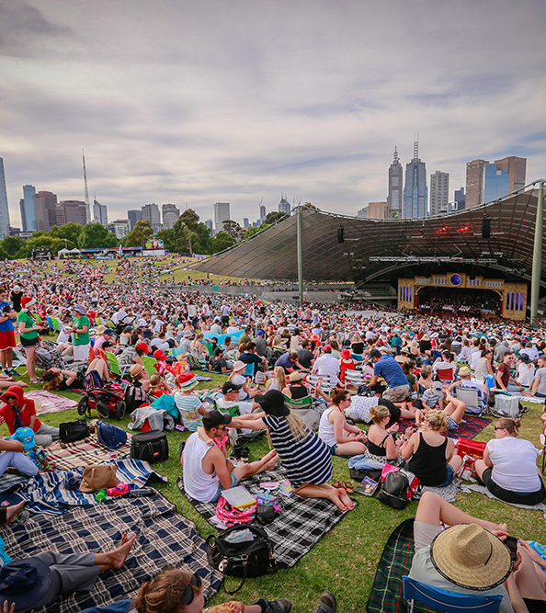
Carols by candlelight
Celebrated at the Sydney-Myer Music Bowl in Melbourne every Christmas Eve.
Popular Australian celebrities, singers, TV personalities and presenters attend to sing and give speeches.
First event was held all the way back in 1938!
About 50,000 people attend to watch live and 2,500,000 million people watch the TV broadcast.

Slide 4
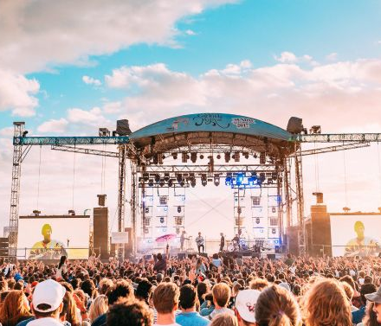
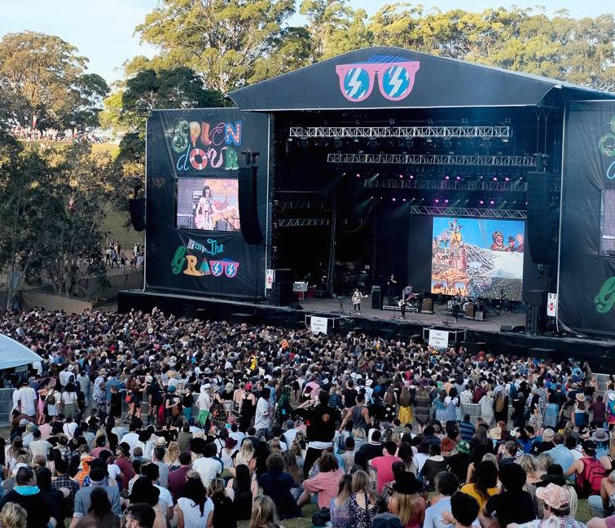
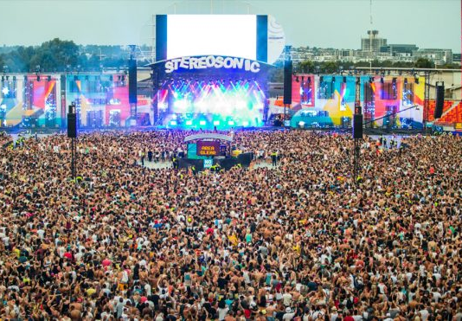
Australian Music Festivals
Splendour in the Grass
Stereosonic
Groovin’ the Moo
Soundwave
DEFQON 1
St. Kildafest

Slide 5
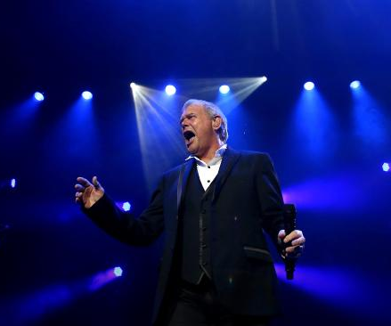
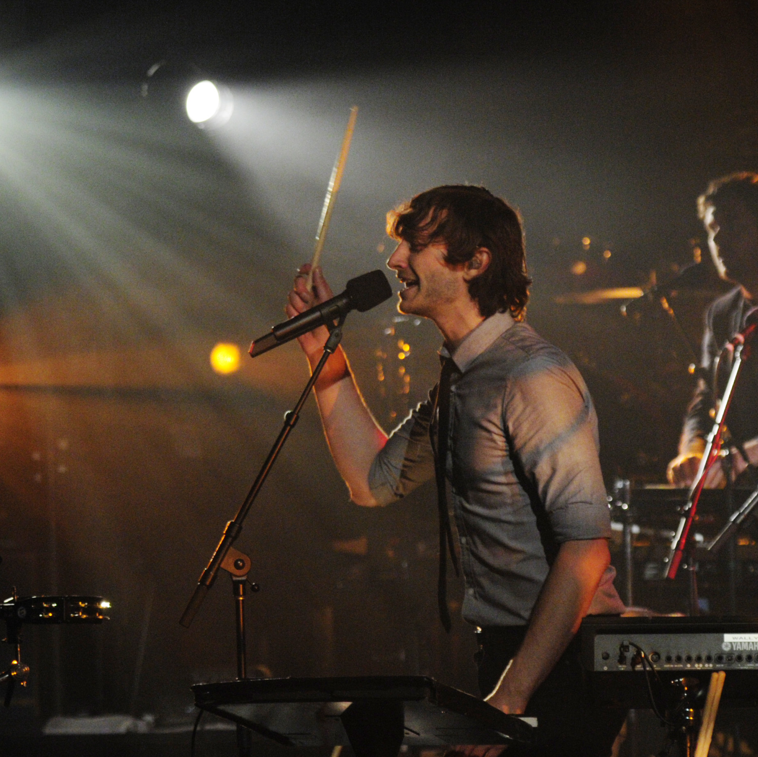
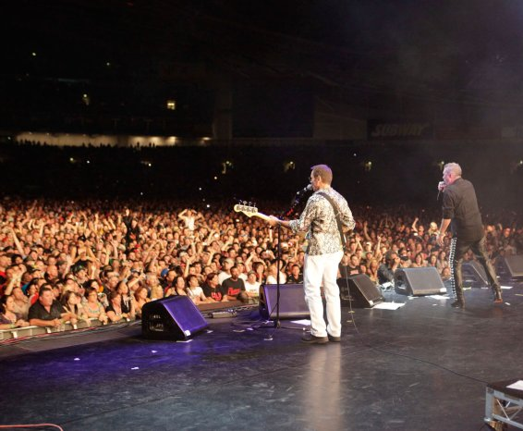
Famous Australian artists
Gotye (Somebody that I Used to Know)
Nick Cave (Graduated in Arts from Monash University)
Jimmy Barnes (Lead singer of Cold Chisel)
John Farnham (You’re the Voice)
Sia
Missy Higgins
Vance Joy
Guy Sebastian

Slide 6
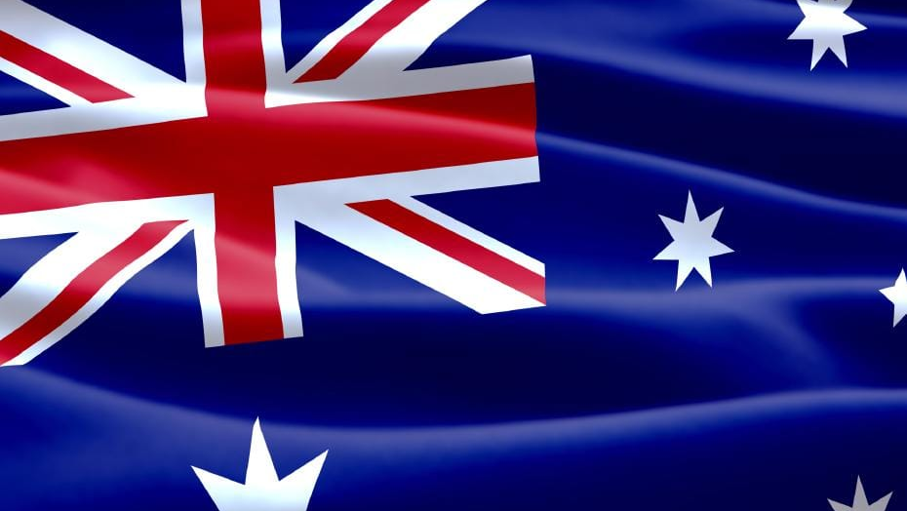
Australian national anthem
Advance Australia Fair.
Replaced ‘God Save the Queen’ as the National Anthem in 1987.
Written in 1878
Advance Australia Fair

Slide 7
Thank you!
Спасибо!

