Slide 1
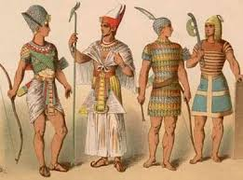
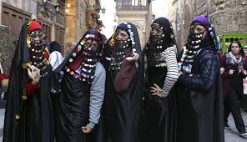
National Costumes in Egypt
Made by: Maysan Tarek

Slide 2
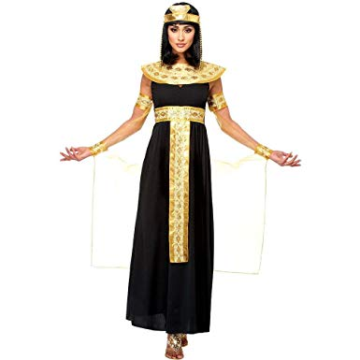
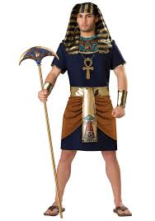
Pharaohs:

Slide 3
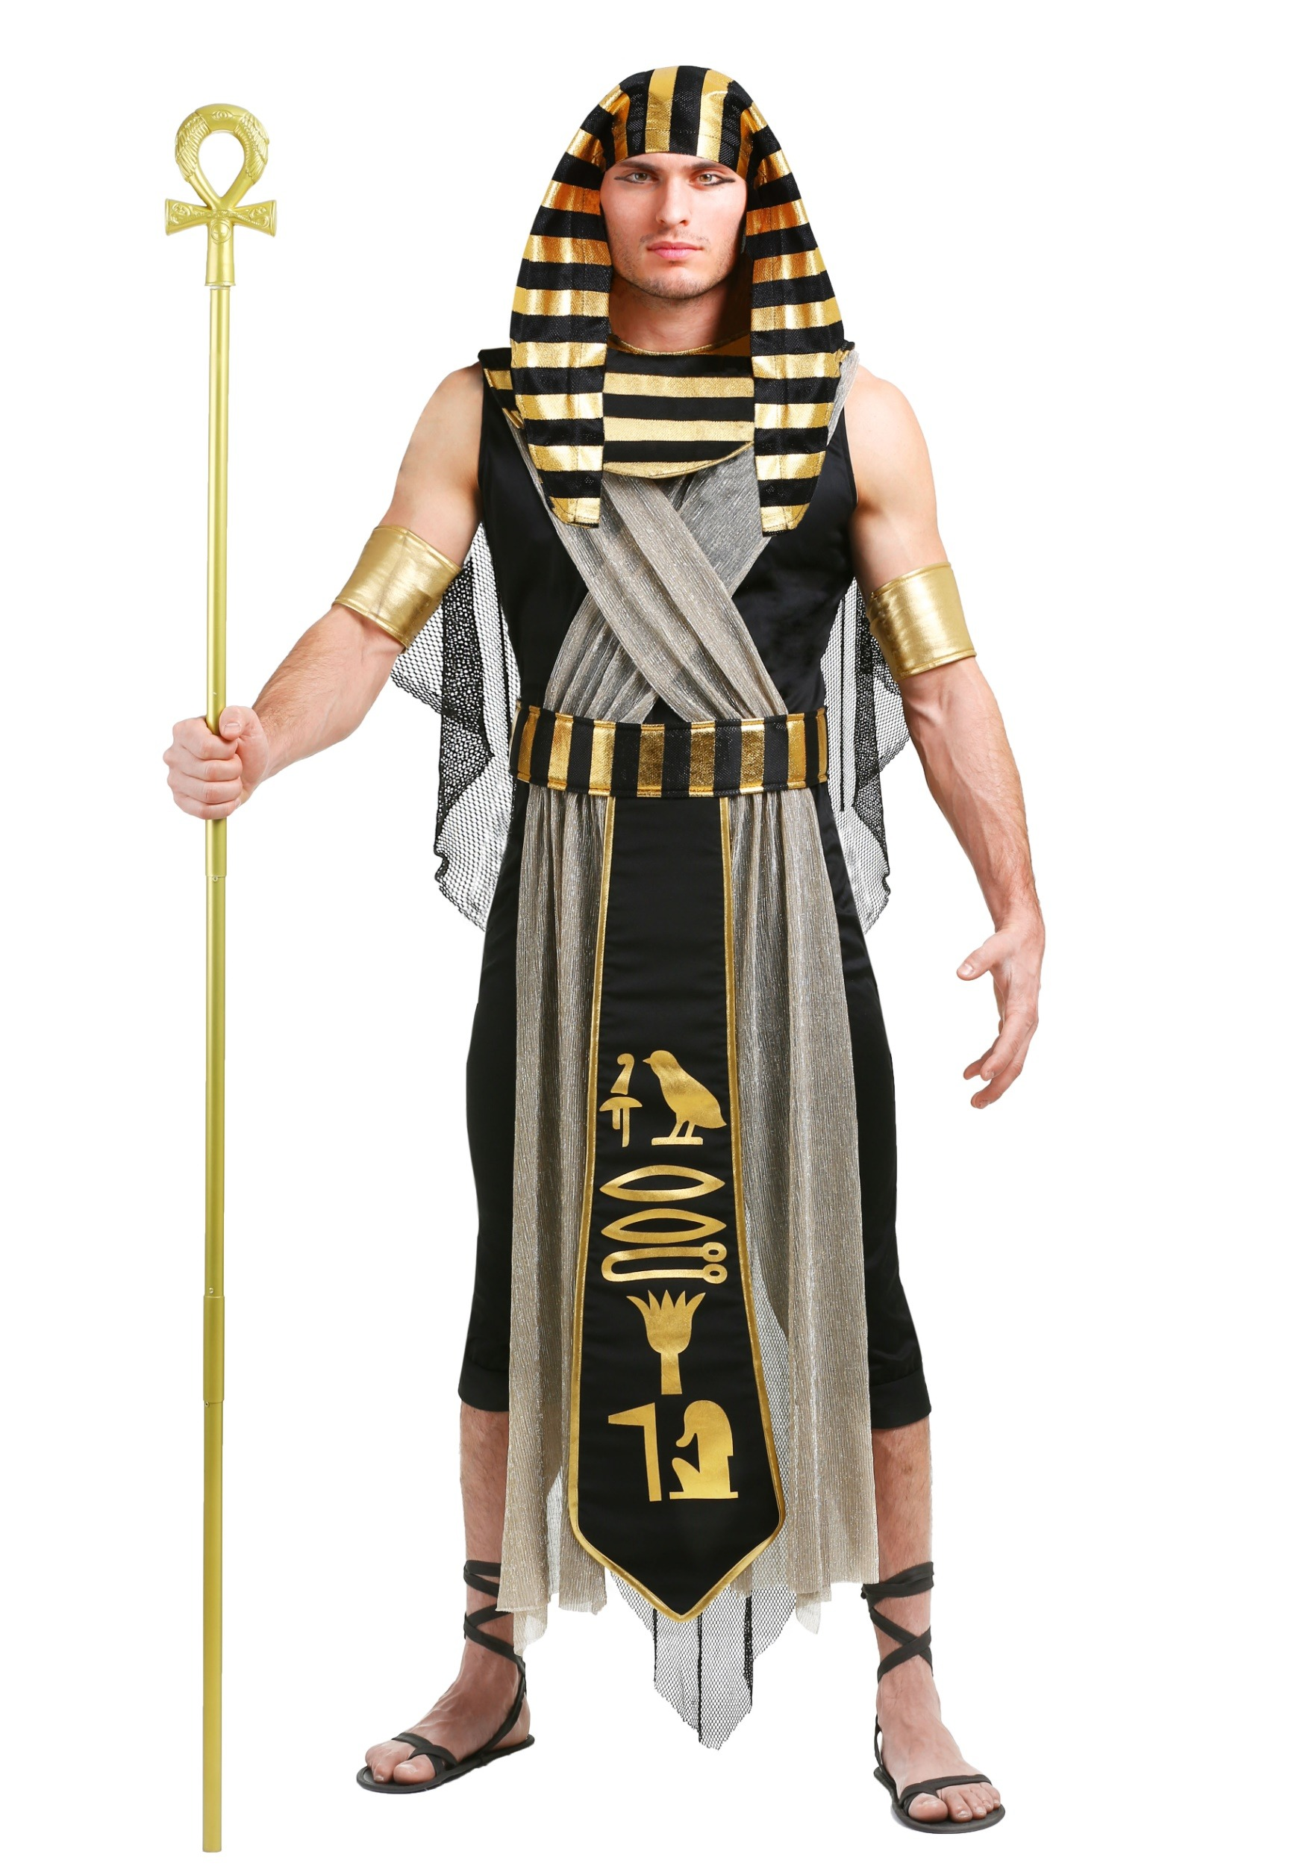
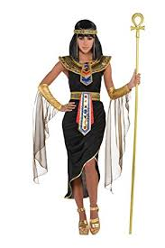
7000 years ago (3100 BC)
Has a variety of colors.
Decorated with precious gems and jewels and it was comfortable for them to move in.
It was created to keep cool in hot weather because Egypt was a desert.

Slide 4
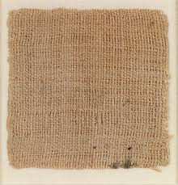
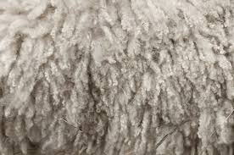
Elements of Egyptian clothing:
Linen :
. The most common textile on these days.
. Helps them to be comfortable in the hot weather.
2. Wool :
. Was only worn by wealthy people.
. Wearing it on occasions only.

Slide 5
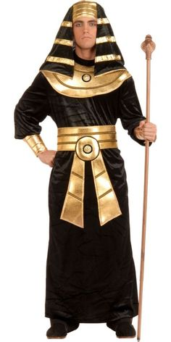
Men:
Men wore wrap around skirts known as the shendyt which are belted at the waist.
They used to wear short skirts but in the middle kingdom of Egypt, after 1000 years it became longer.
After 500 years, there was w light blouse with sleeves they can wear on light skirts.

Slide 6
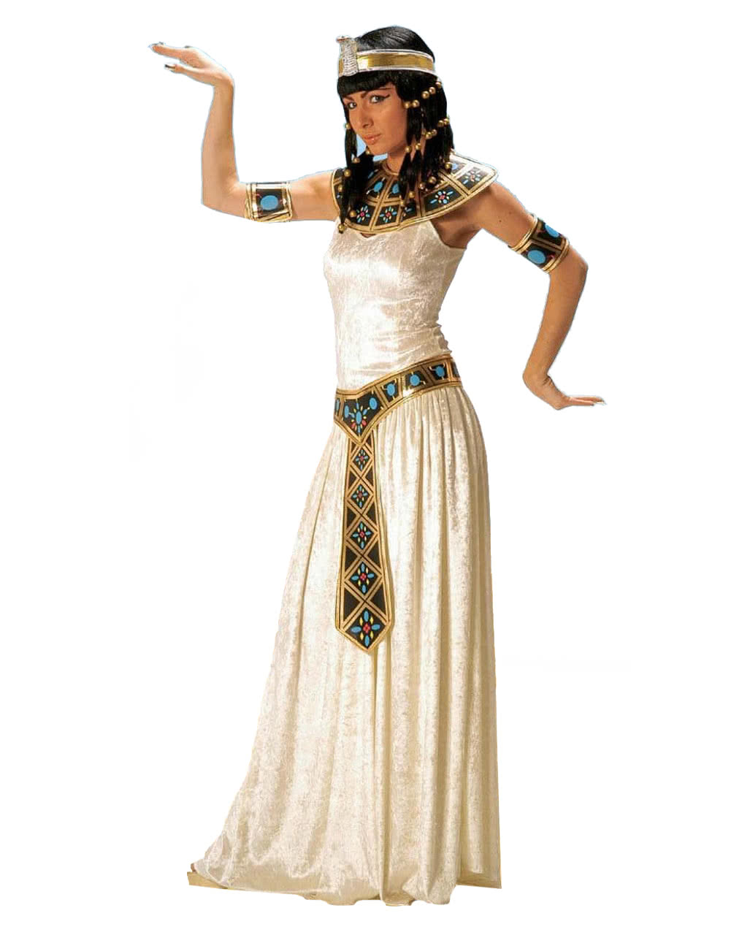
Women:
Egyptian women used to wear a dress called kalasiris.
Women’s clothing were more traditional than men’s.
The length of the dress shows the social class. (poor / wealthy)
Women had a choice of wearing shawls , capes ,or robes over their dresses.

Slide 7
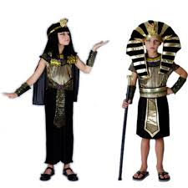
Children:
Children that age less than 6 years don’t wear clothes, when they turn 6 they start wearing clothes to protect them from the heat of the sun.
There is one popular hairstyle among children that is called ‘Side Lock’ : it is unshaved length of hair on the right side of the head.
They usually wear jewelry like anklets, bracelets, collars and hair accessories.
When they grow up they dress like their parents.

Slide 8
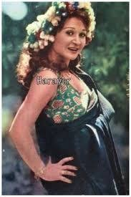
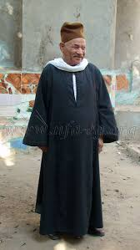
Alexandrians:

Slide 9
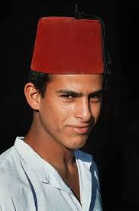
154 years ago (1865)
Comfortable and easy for a northern city.
Women depends on their beauty and the accessories they’re wearing. (anklets and bracelets)
It shows the social state.

Slide 10
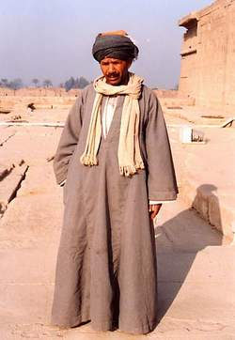
Men:
The most traditional Alexandrian Egyptian costume for men is a long shirt called ‘Galabeyah’.
They wear under the galabeyah a trousers like thing called ‘serwal’.
Easy to move and work with it because it’s oversized.
Can be good for cold and hot weather.

Slide 11
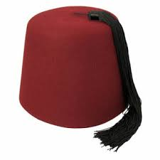
Male headwear:
It’s called Tarboush.
It was a must to wear it by an order of Sultan Mahmoud Khan ll, king of Egypt.
It shows that the men how wear it follow the rules and he is decent.

Slide 12
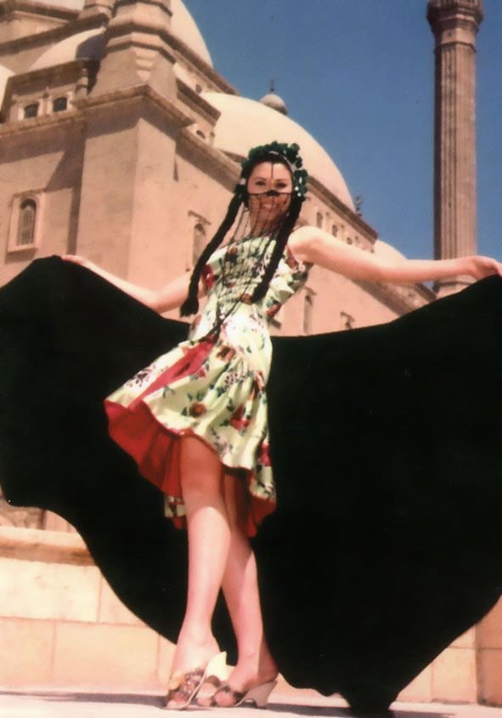
Women:
A short dress and w black piece of cloth wrapped on the body.
It’s called ‘ Melayah Laff’ or ‘roll mop’ , and it shows the beauty of the women and doesn’t cover it.
Melayah laf became an essential part of women’s cpstumes.
In 1980s people stopped wearing it.

Slide 13
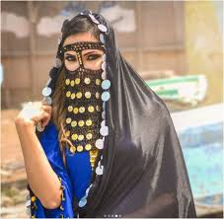
Female facewear:
It’s called Burqu’.
One of the most important things that women used to depend on in their look.
It increases their beauty.
It disappeared in the same time of the roll. (1980s)

