Slide 1
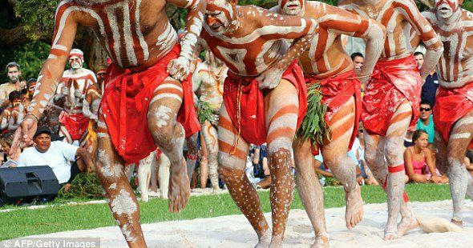
Traditional Dress of the Australian Indigenous People
Jordon young

Slide 2
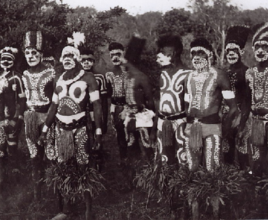
Why do Indigenous Aussies Dress up?
Dancing ceremonies to commemorate the departure/arrival of foreign tribes
To celebrate significant events of the dreamtime (aboriginal faith)
To celebrate “coming of age” when a boy becomes a man

Slide 3
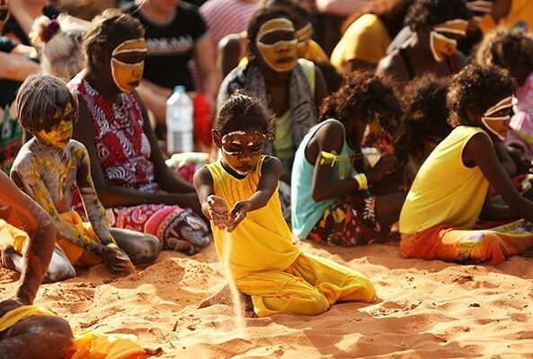
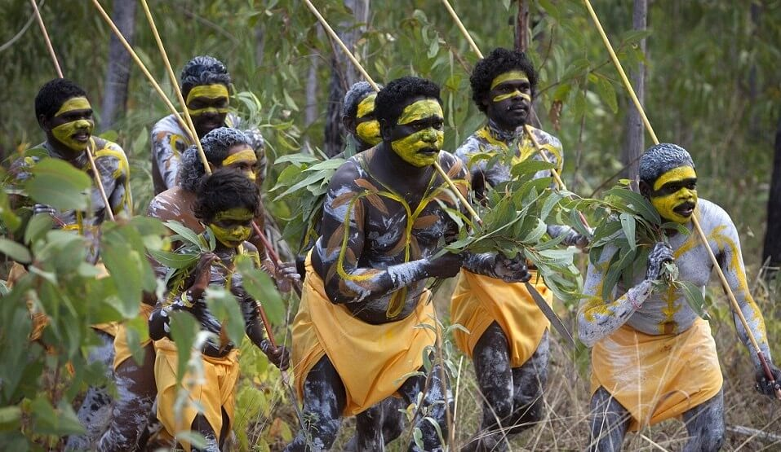
Traditional Dress: Body Paint
Indigenous Australians paint their bodies for ceremonies
Only men can paint their bodies
Different patterns, colour and styles signify age, status and tribe
Normally painted using natural extracts from plants

Slide 4
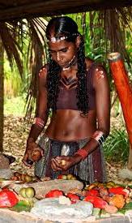
Clothing
Woven out of silks, reeds and palm leaves
Dyed using plant extracts to tribe colours
Include head-dresses, piercings, robes and leggings
Ornamental necklaces of teeth, bones and shells are also worn

Slide 5
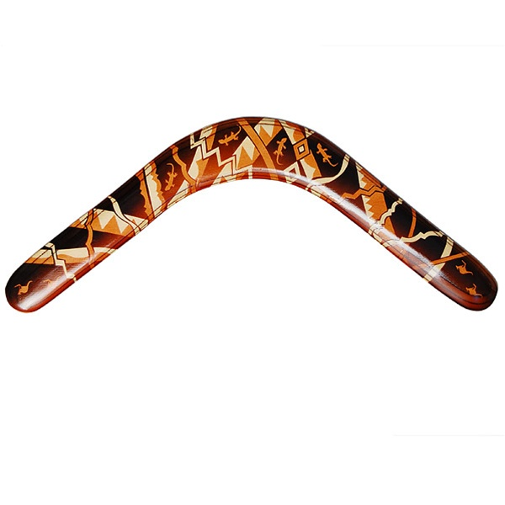
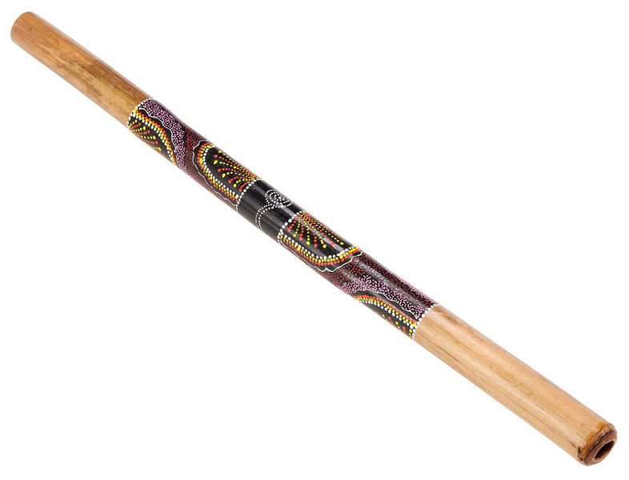
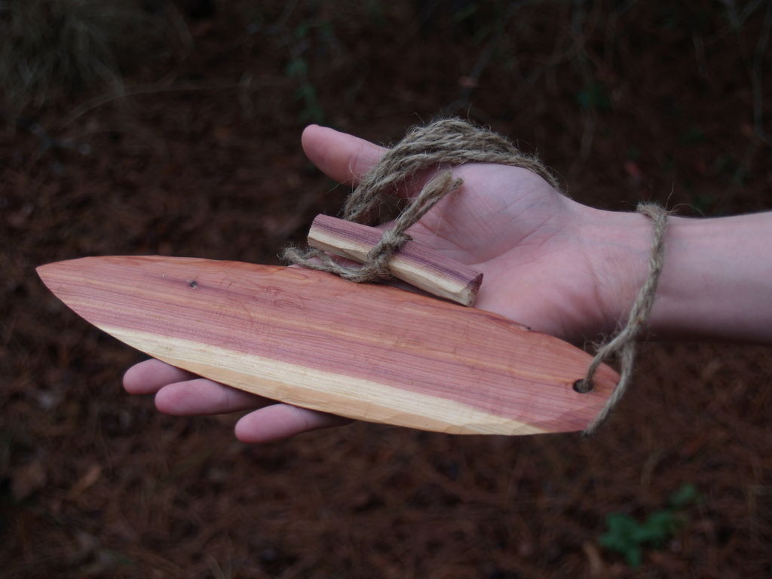
Symbolic objects and items
Boomerang
Didgeridoo
Noise maker

